Slide 1
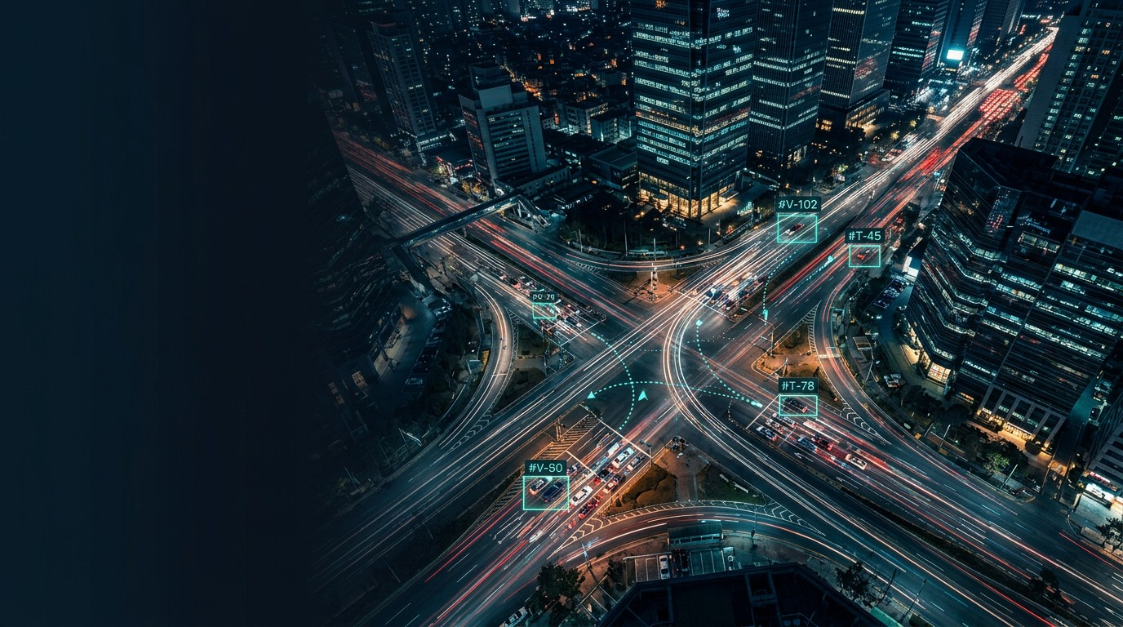
Vehicle Tracking &
Collision Warning
Detection → Tracking → Path Mapping → Speed & Prediction
Presented by Group 8

Slide 2
Problem & Goal
The Objective
Transform a video stream into actionable, real-time motion intelligence.
System Outputs
For every vehicle in the frame, we extract:
Unique Track ID
Current mapped position
Estimated speed (px/frame)
Near-future trajectory
End Goal
Early collision risk warning based on short-horizon prediction.
Raw Video
Stream
Detection
& Tracking
Collision Warning Logic

Slide 3
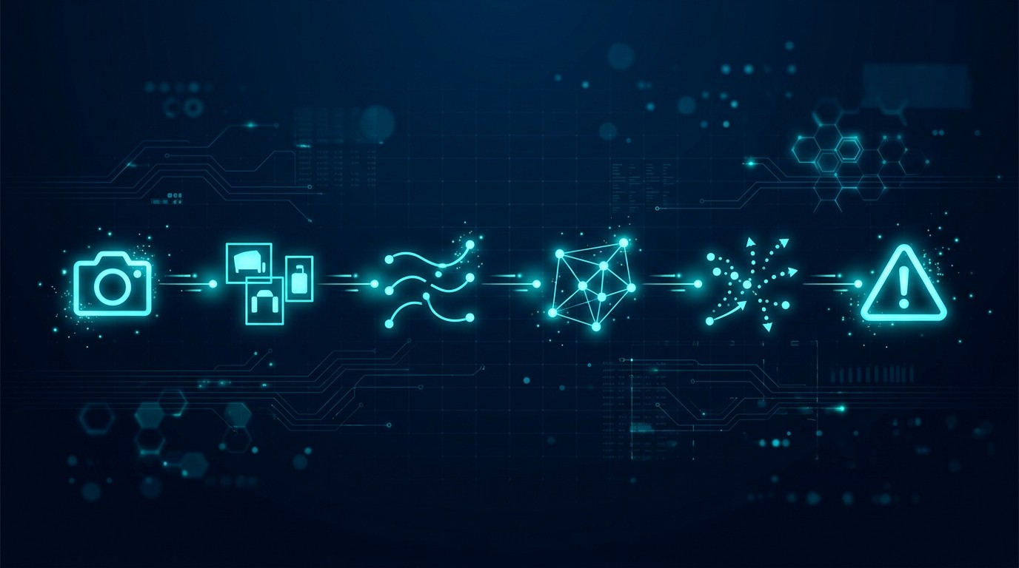
End-to-End Pipeline
1. Detection
YOLO bounding boxes & conf
2. Tracking
ByteTrack assigns Track IDs
3. Mapping
KDTree maps to path coords
4. Prediction
History yields speed & future pts
5. Warning
Trajectory comparison risk
Modular, frame-by-frame architecture ensures real-time applicability.

Slide 4
Vehicle Detection
Detection quality sets the ceiling for the entire tracking and prediction system.
YOLO Architecture
Utilizes custom YOLO weights (best.pt) trained specifically for vehicle and object recognition in traffic scenes.
Confidence = 0.25
A balanced threshold chosen to reduce missed detections of distant cars while filtering out low-confidence false positives.
Supervision Library
Standardizes raw YOLO outputs into a structured format (sv.Detections) making downstream tracking seamless.
Frame-to-Tracker
Each frame's bounding boxes are fed instantly to the tracker; no batching, ensuring real-time capabilities.

Slide 5
Multi-Object Tracking (ByteTrack)
Maintaining a stable vehicle identity (TID) across frames despite detection noise.
1
Kalman Prediction
Estimate new position of existing tracks
Track ID (TID)
Each unique vehicle is assigned an integer ID that persists as long as the vehicle is visible.
Trajectory Deque
We maintain the last 21 frames (approx. 0.7s at 30fps) of center coordinates for each TID. This is crucial for calculating velocity and predicting the immediate future.
2
Data Association
Match boxes via IoU & motion
3
History Update
Store centers in deque (HISTORY_SIZE=21)

Slide 6
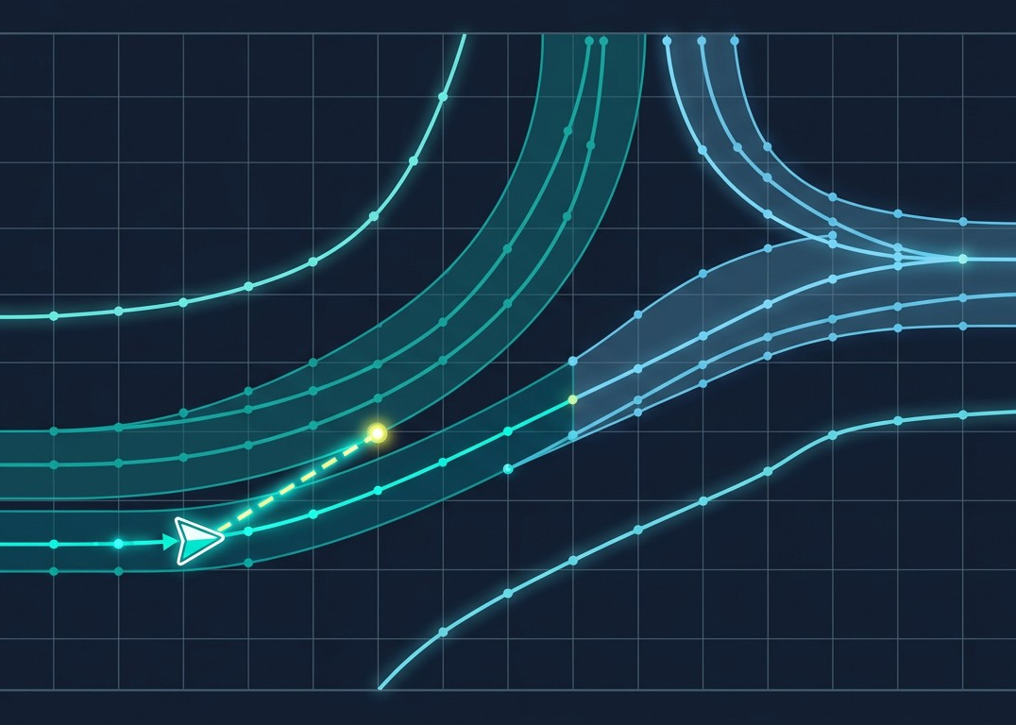
Path Mapping via KDTree
1. Build KDTree
Preload reference path coordinates and construct SciPy KDTree once.
2. Query Nearest
For each vehicle (cx, cy), query tree for closest path node & index.
3. Threshold Filter
Assign to path only if distance < 25px, filtering outliers.

Slide 7
Speed & Future Prediction
3. Project Future
Extrapolate vector to generate multi-step future dots.
2. Velocity
Calculate displacement over frames (px/frame).
1. Extract History
Retrieve recent (x,y) centers from the TID deque.
A simple linear/kalman projection creates the short-horizon trajectory needed for risk assessment.

Slide 8
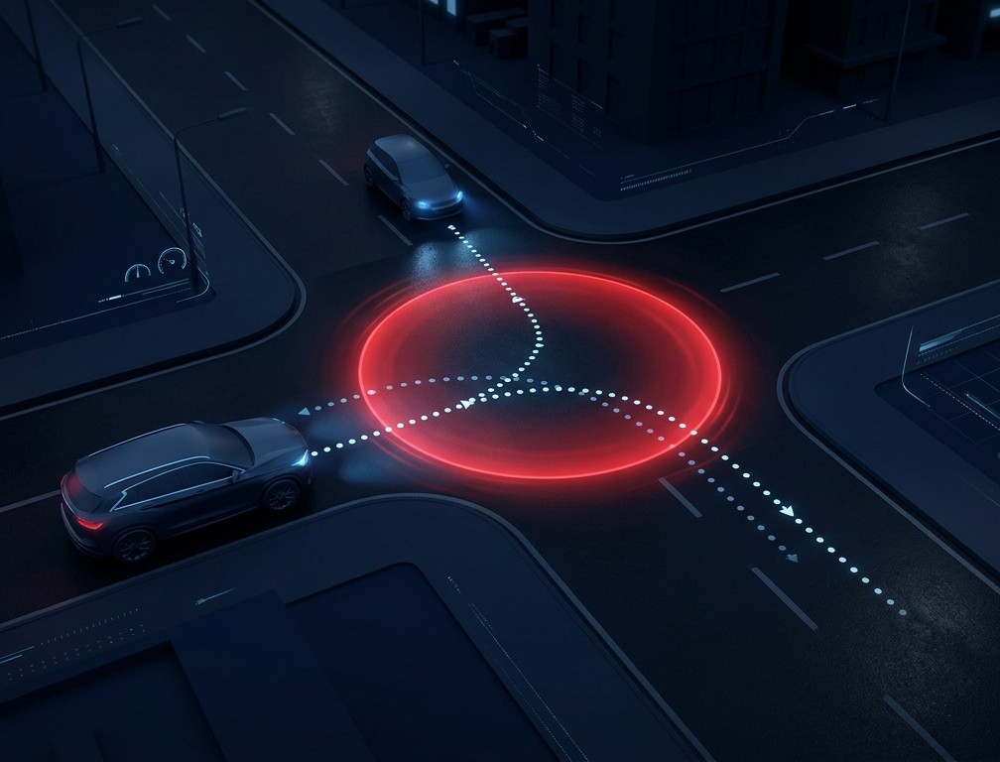
Collision Risk Detection
Prediction-to-Prediction
Instead of current bounding boxes, we compare the predicted future trajectories of all vehicles.
Aligned Time Steps
Compare points at matching future frames (e.g., T+1 vs T+1, T+2 vs T+2).
Distance Threshold
If Euclidean distance < 0.5 *(car size a + car size b), trigger warning.
Risk Scoring
Closer time-steps yield a higher risk flag (e.g., collision at T+1 is more critical than T+5).

Slide 9
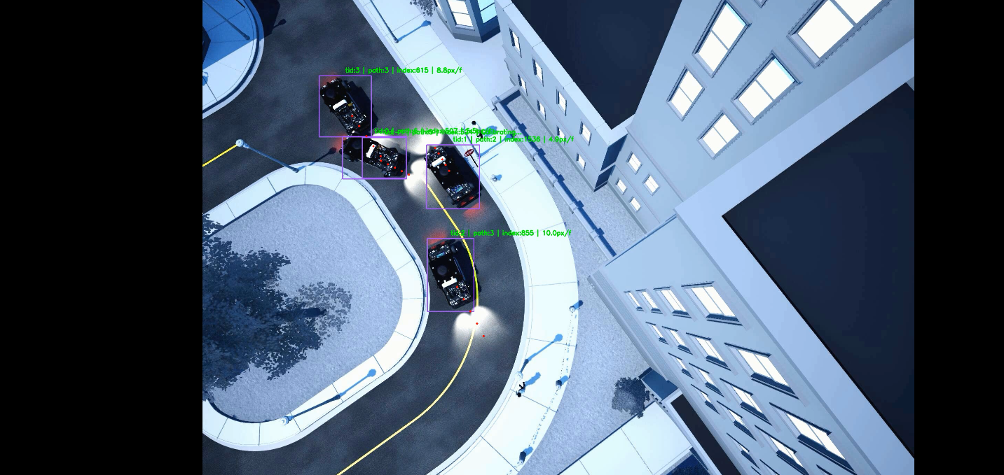
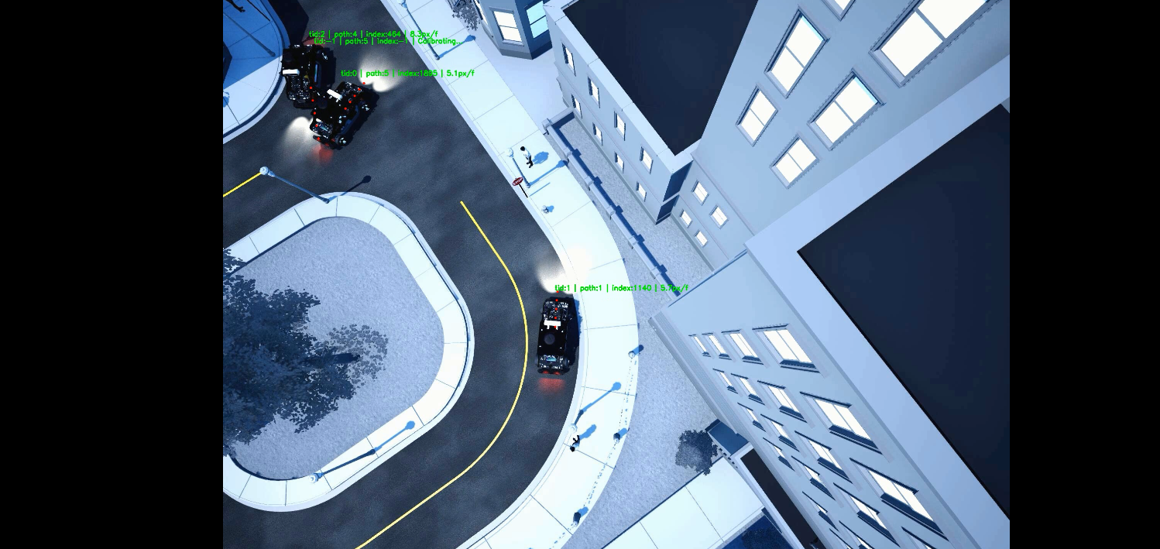
Prediction Results & Error Analysis
Overall Accuracy: 38/40
Collision Videos: 19/20 | Normal Videos: 19/20
False Negative: Video #13
One vehicle misidentified as two before impact. Raising confidence threshold to fix this causes missed detections during actual collisions.
False Positive: Video #12
Visual ambiguity. From this camera perspective, the vehicles appear to scrape each other, triggering the distance threshold.

Slide 10
Demo Outputs & Observations
Annotated Video UI
Bounding boxes with persistent Track IDs (TID)
Velocity overlays shown dynamically above vehicles
Dotted trajectory lines extending ahead of current position
Flashing text labels & highlighted boxes upon high collision risk
Observations & Edge Cases
ID Switches: Heavy occlusion behind cars can cause a tracker to assign a new ID upon reappearance.
Weak Rear-end Collision Detection: The system relies on predicting overlap between simplified circular bounding volumes. Due to the rapid longitudinal movement of vehicles, a rear-end collision is often only detected when physical contact has already occurred, failing to provide the necessary buffer for proactive braking..
Path Ambiguity: paths share a same part may leads to a wrong label at first.

